Slide 1
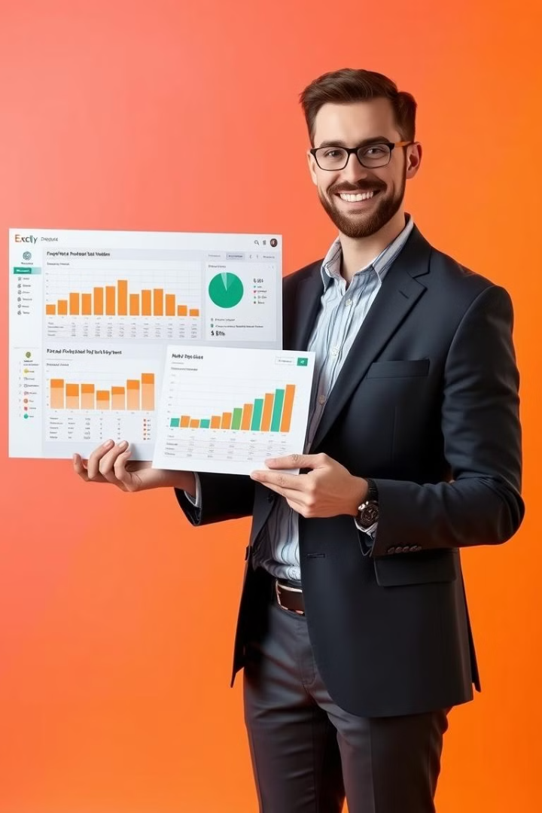
"Excel Case Study: Sales and Customer Analysis"
This presentation provides an overview of a sales and customer analysis case study conducted using Microsoft Excel. The analysis focuses on key performance indicators and trends to provide actionable insights.
Presented by Md Aamir Nawab on 02/03/2025.

Slide 2

Project Overview
1
Objective
2
Dataset
Analyzing sales, cancellations, customer spending, and creating an interactive dashboard.
Transactions: InvoiceNo, Date, Amount. Products: StockCode, Description, Unit Price, Quantity. Customers: CustomerID, Country.
3
Excel Functions
Pivot Tables, SUMIFS, COUNTIF, IF, Charts, Dashboards

Slide 3

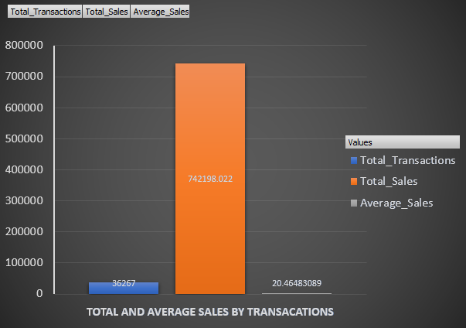
Total Sales Performance
Sales Amount
Transaction Volume
Average Sale
Total sales: 742,198.022. High effectiveness of sales transactions.
Total transactions: 36,267. Suggests high customer engagement.
Average sale: 20.46. Customers make frequent small purchases.
Introduce bundling strategies. Offer discounts on bulk purchases. Analyze pricing. Run limited-time offers.

Slide 4

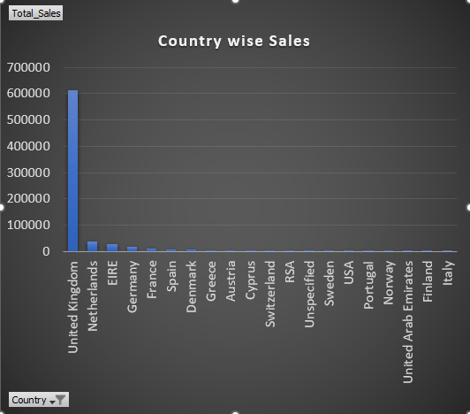



Geographical Distribution
UK Market
Other Countries
Low Sales
Dominant market with highest sales.
Moderate sales in the Netherlands, Ireland, Germany, and France.
Some countries have negligible sales.
Invest in the UK. Offer exclusive deals. Improve shipping options. Explore partnerships.

Slide 5

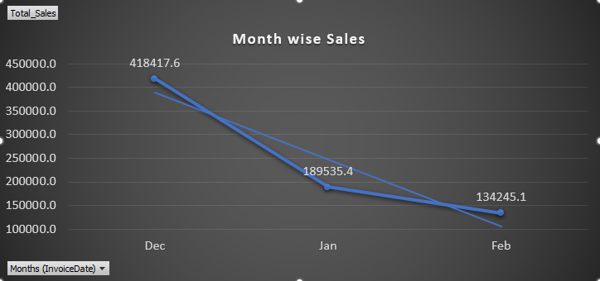
Sales Trend Analysis
1
December Peak
December: 418,417.6. Benefited from holiday sales.
2
January Drop
January: 189,535.4. Post-holiday sales slump.
3
February Low
February: 134,245.1. Customers reduced spending.
Maximize December sales. Plan inventory in advance. Use email marketing. Offer discounts.

Slide 6

Conclusion
Key Insights
Growth Focus
UK is dominant. Seasonal trend in December. Need post-holiday strategies.
Targeted marketing, promotional campaigns, and customer retention.
Action Items
Optimize Product Pricing & Promotions
Optimize inventory, pricing, and implement sustainable revenue growth.
•Run limited-time offers or flash sales to encourage impulse purchases.

Slide 7

For watching the explanation video Click : Link_1 Link_2
Thank you.

